Slide 1

Event Management
Team Mentor:
A.Abinaya

Slide 2

Introduction
The Event Management System is a comprehensive platform designed to simplify the planning, organization, and execution of events. It addresses the challenges of traditional event management by offering a digital solution that enhances efficiency, transparency, and user experience.

Slide 3
Problem statement
Inefficient Coordination: Manual processes often lead to communication gaps among stakeholders. Time-Consuming Tasks: Planning, scheduling, and tracking events can be cumbersome. Participant Management Issues: Difficulty in managing registrations, cancellations, and feedback. Lack of Insights: Limited data analytics to measure event performance.

Slide 4

Solution Overview
The Event Management System is a web-based platform that
event scheduling, participant registration, and task Automates allocation. Offers real-time updates and notifications.
Provides a user-friendly interface for administrators and participants.

Slide 5
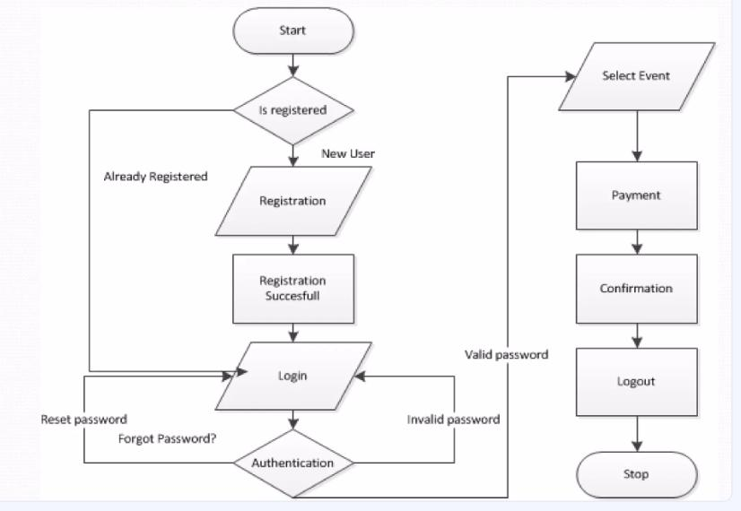
Key Features
Admin Panel:
Event creation, modification, and deletion.
Role-based access and permissions. User Interface: Easy event browsing and registration. Personalized notifications and reminders.
Additional Features: Payment gateway integration . Calendar synchronization for reminders.

Slide 6
Technology and architecture
Frontend: HTML , CSS , Java script Backend: Flask, Python Database: MySQL or MongoDB

Slide 7
Challenges and Solutions
Challenge: Ensuring seamless integration between modules. Solution: Modular design and thorough testing.
Challenge: Handling high user traffic during peak times.
Solution: Cloud-based scaling and optimized queries.

Slide 8
Future Scope
AI Integration: Personalized event recommendations based on user preferences.
Mobile App Development: Extend accessibility to mobile platforms. Advanced Analytics: Predictive insights for event trends.
Virtual Events: Support for hybrid and fully virtual events.

Slide 9
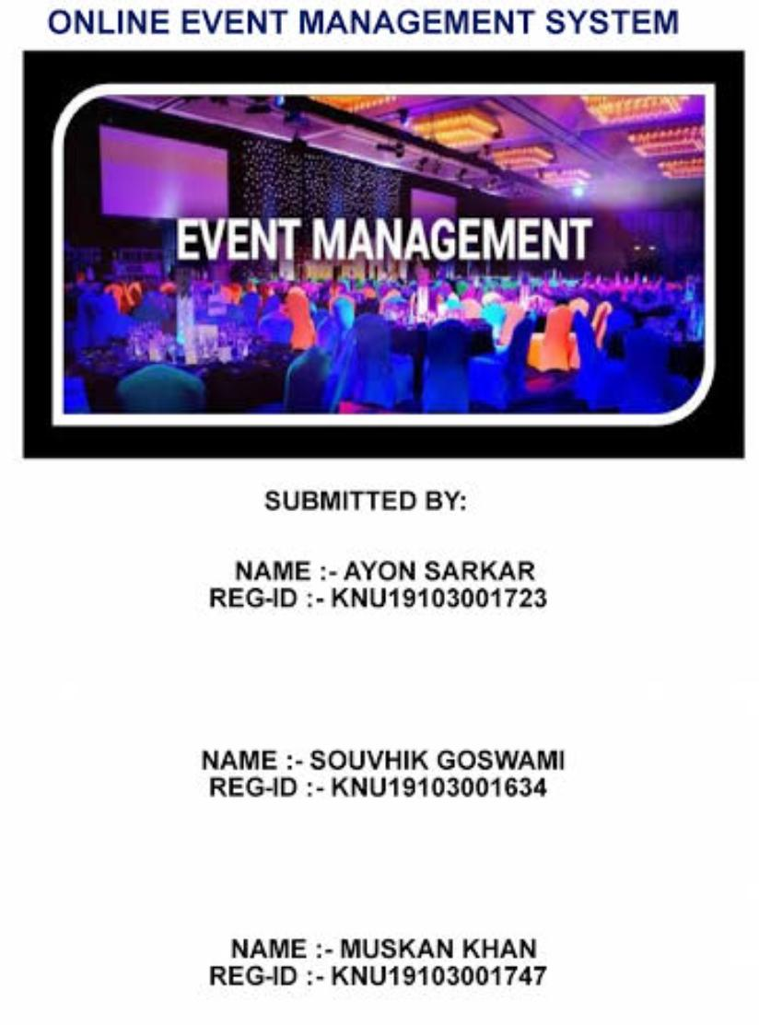
Results
Enhanced efficiency in event management. Reduction in manual errors and time consumption. Improved user satisfaction with streamlined processes. Increased participation rates due to better accessibility and communication.

Slide 10
Conclusion
The Event Management System successfully addresses the challenges of traditional methods by offering a robust and scalable digital solution. It streamlines processes, enhances user experience, and paves the way for data-driven decision-making, ensuring the success of events in a dynamic environment.

